Slide 1
Analysis of the trends of post-secondary education in Singapore
PDS CA2
Done by: Lim Chuan Hao(1922264)
DIT/FT/1B/11

Slide 2
Datasets used
Enrolment - Secondary, By Level and Course (Dataset 1)
https://data.gov.sg/dataset/enrolment-secondary-by-level
Enrolment - Pre-University, By Level and Course (Dataset 2)
https://data.gov.sg/dataset/enrolment-pre-university-by-level
Polytechnics - Intake, Enrolment and Graduates by Course (Dataset 3)
https://data.gov.sg/dataset/polytechnics-intake-enrolment-and-graduates-by-course
Universities - Intake, Enrolment and Graduates by Course (Dataset 4)
https://data.gov.sg/dataset/universities-intake-enrolment-and-graduates-by-course
Graduate Employment Survey - NTU, NUS, SIT, SMU & SUTD (Dataset 5)
https://data.gov.sg/dataset/graduate-employment-survey-ntu-nus-sit-smu-sutd

Slide 3
Sub-objectives explained
There are 2 main sub-objectives crafted to analyze the overall objective
Junior College (JC) or Polytechnic (Datasets 1, 2 and 3)
Which is more popular?
Which is harder to graduate?
Which field of study should I go into (Datasets 3, 4 and 5)
Which field of study is more popular?
Which field of study has better job prospects?

Slide 4
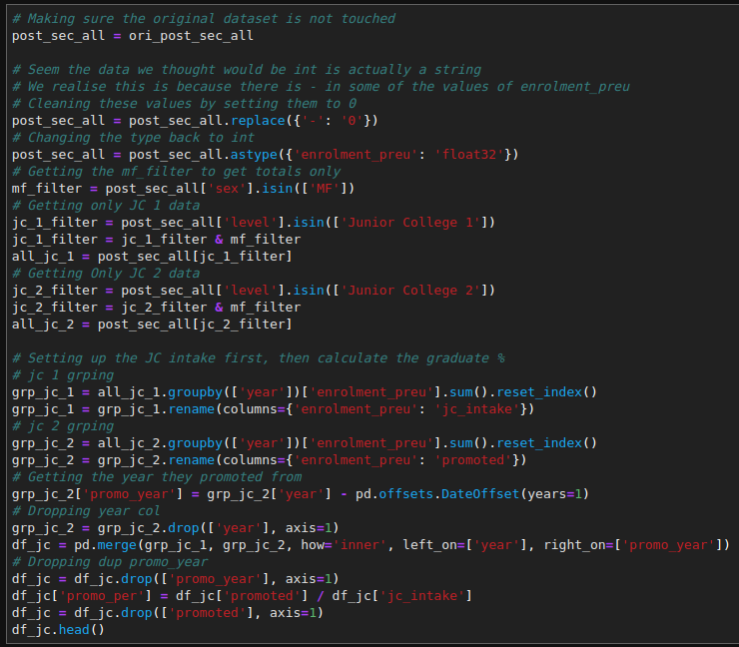
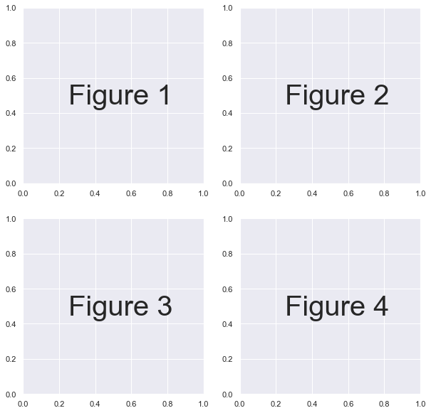
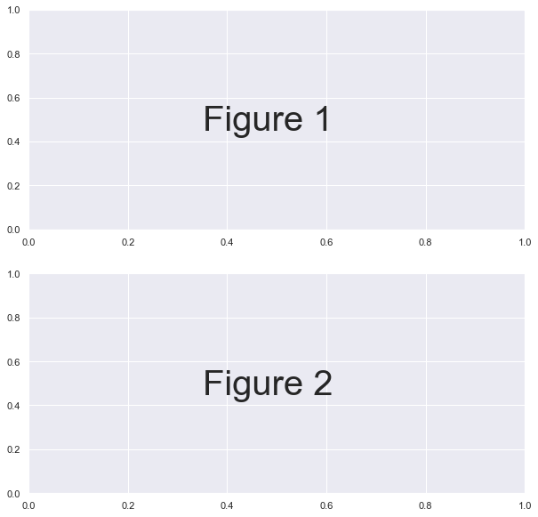
Some notes
A more detailed explanation of the code and conclusion will be in the notebook.
Example shown below:
I will be referring to the figures in the order as shown below

Slide 5
Sub-objective 1(Datasets 1, 2 and 3)
Junior College (JC) or Polytechnic (Datasets 1, 2 and 3)
Which is more popular?
Which is harder to graduate?

Slide 6
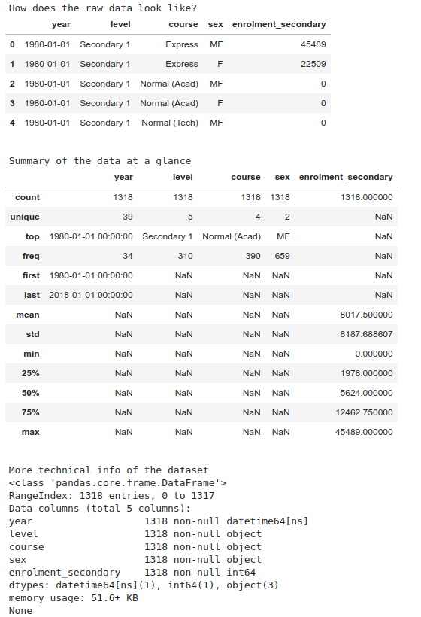
Some quick analysis of the datasets
An example of the output:
Enrolment - Secondary, By Level and Course (Dataset 1)
5 Columns
['year', 'level', 'course', 'sex', 'enrolment_secondary']
1318 Rows
Enrolment - Pre-University, By Level and Course (Dataset 2)
5 Columns
['year', 'level', 'course', 'sex', 'enrolment_preu']
1166 Rows
Polytechnics - Intake, Enrolment and Graduates by Course (Dataset 3)
6 Columns
['year', 'sex', 'course', 'intake', 'enrolment', 'graduates']
336 Rows

Slide 7
Data manipulation and Cleaning (Dataset 1)
Mainly for this dataset, I wanted to find out the number of eligible students that can move on to post-secondary education (JC or Poly)
For this I mainly assumed the Normal (Academic) Secondary 4 and 5 and Express Secondary 4 students that graduated every year were able to move on to post-secondary education
I filtered for the students and then further filtered it to only be taking the totals of male and females.
Then I grouped by year and summed up the total graduates, to get the total number of students eligible for post-secondary education.
Then I offset the year by 1 to make sure the previous year graduates were the total potential intake of next year
Limitations:
I assumed the total number of students that were eligible for post-secondary education as above
I also only assumed they could have gone for JC or Poly, there are other options I did not account for.

Slide 8
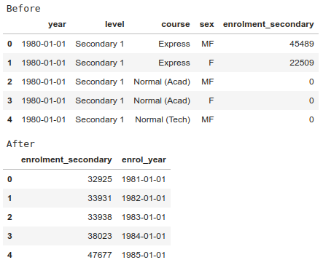
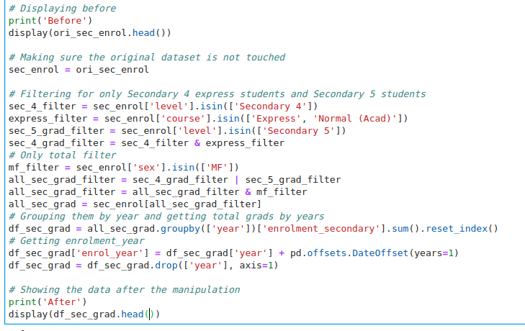
Data manipulation and Cleaning (Dataset 1)

Slide 9
Data manipulation and Cleaning (Dataset 2)
I took the enrolled year 1 JC students as that year’s intake of students
I also took the current year 2 students enrolled and took them as having passed promos
I then compared it to the previous year ‘intake’ to see the passing %
I will be using passing promo’s to compare with graduating Poly later on
Filtered similarly to dataset 1, took only total values and drop all null values

Slide 10
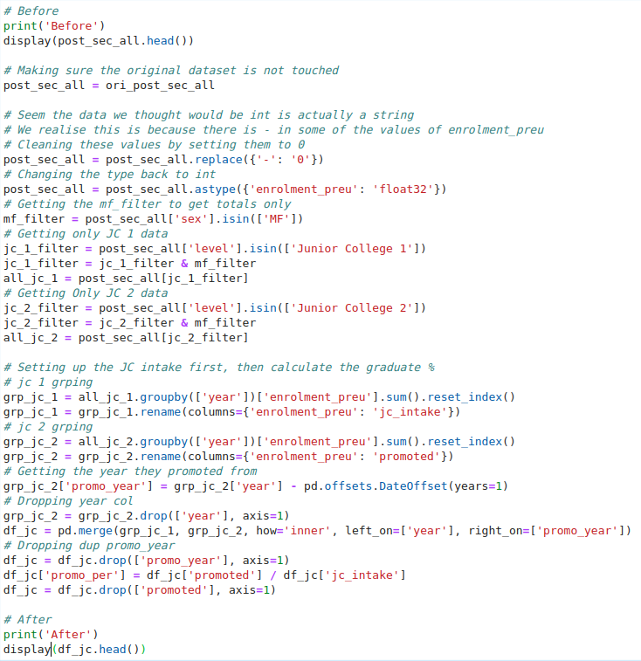
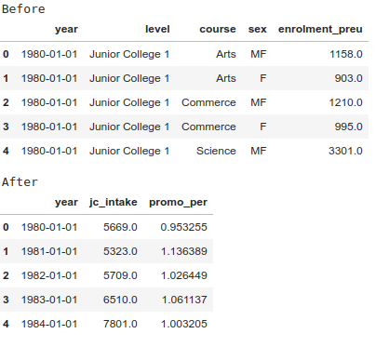
Data manipulation and Cleaning (Dataset 2)

Slide 11
Data manipulation and Cleaning (Dataset 3)
Same as the previous 2, I took only the intake and graduates
I also only filtered it to only have totals of both male and female
Cleaned up missing values to turn some columns from string back to floats
Then grouped by year to get intake and graduates by year
Assumed a normal graduate would graduate in 3 years, thus compared number of graduates to 3 years before

Slide 12
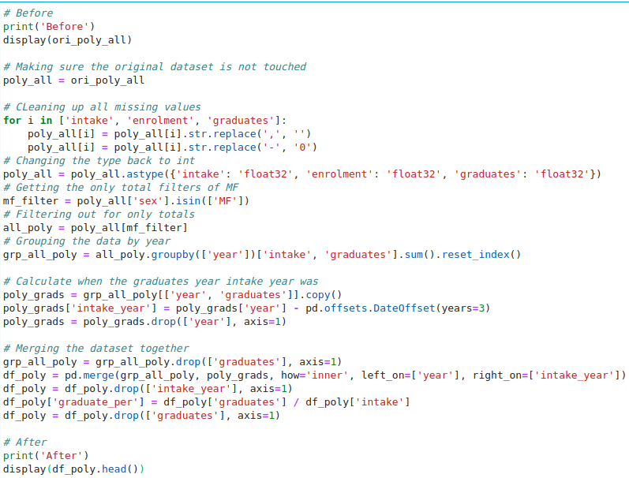
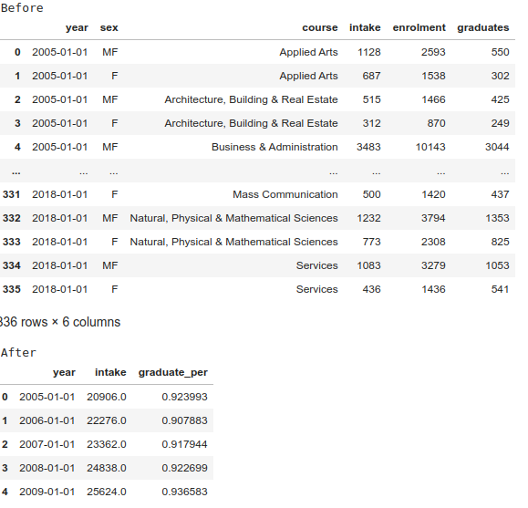
Data manipulation and Cleaning (Dataset 3)

Slide 13
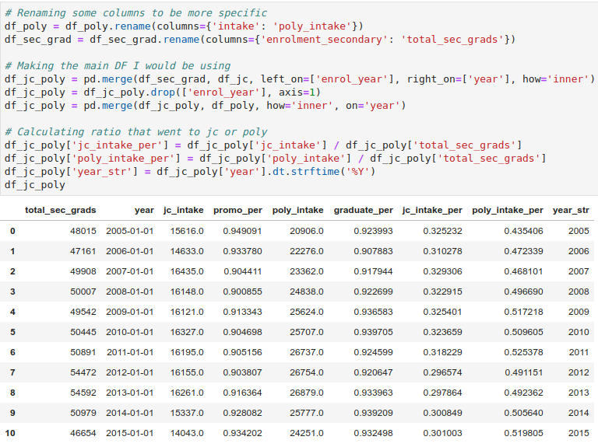
Final dataframe used here
Mainly merged all the datasets above into one large dataframe
Mainly used the time as the matching key to merge
Carefully removed any columns not being used and also rename columns to not get confused

Slide 14
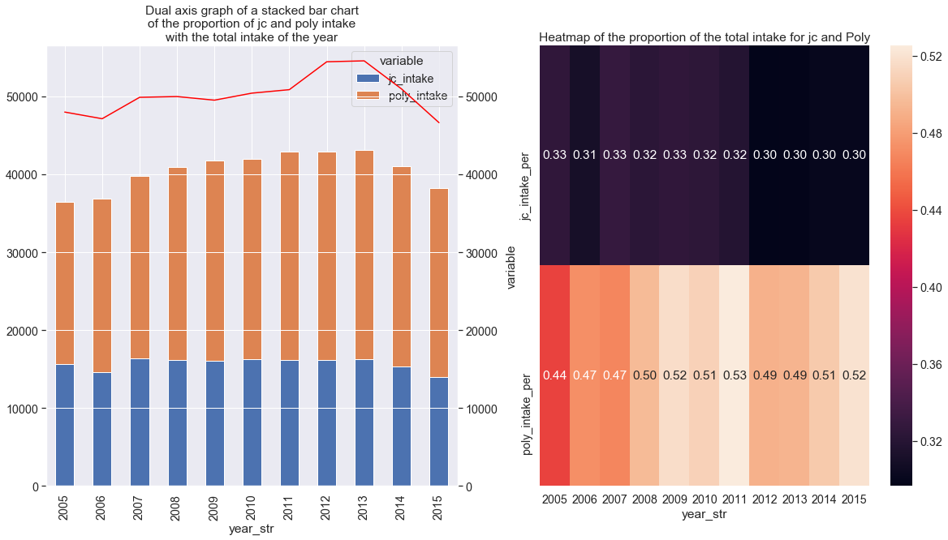
Analyzing the graphs
Figure 1
We can see that there is a larger majority of people going to poly instead of JC
We can also see that the people choosing to go to Poly is increasing over the years
However, note how after 2012, the total number of people that can go into post-secondary education has dropped, so with the total number of JC and Poly intake
Figure 2
We can see here that by proportion, JC has been steadily decreasing in intake year by year.
We can also see that in contrast, the proportion choosing to go to poly has been increasing.
Conclusions:
We can see clearly that Polytechnic is gaining popularity as more people are choosing Polytechnic over JC
However, the total number of students that can go into post-secondary education has been decreasing in recent years.

Slide 15
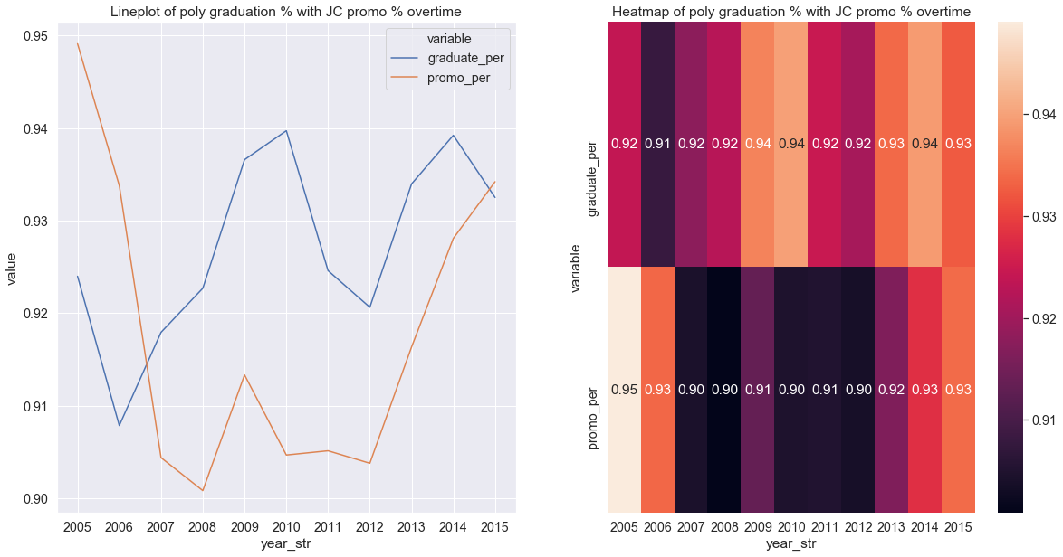
Analyzing the graphs
Figure 1
We can see that mostly poly was much easier to graduate as compared to JC passing promos
Note the axis as the actual difference is about 4% of difference
Figure 2
Snae thing here as we can see the gradients gradually become the same tone of orange at the end
Conclusions:
We can see that at the start, poly was noticeably easier compared to JC by about 3%, however nowadays, we can see that the difficulty in either institute is about the same.

Slide 16
Final conclusions
Sub-Objective: Junior College (JC) or Polytechnic (Datasets 1, 2 and 3)
Which is more popular?
We can see that poly is definitely more popular compared to JCs, both in terms of shear number as well as proportion.
Both actually take up the majority of the students after they graduate from secondary school. (80% and above)
Note the limitations
Which is harder to graduate?
We can see that poly is slightly easier in the past to graduate, but nowadays it is about the same
Note the limitations of comparing graduating poly to passing promos in JC

Slide 17
Sub-objective 2(Datasets 3, 4 and 5)
Which field of study should I go into (Datasets 3, 4 and 5)
Which field of study is more popular?
Which field of study has better job prospects?

Slide 18
Data manipulation and Cleaning (Dataset 3)
Firstly, I cleaned up all the missing values as before and took only the total of male and females
Then I mapped a new column of the course to their field of study
For this and subsequent datasets I have the following field of studies
Arts
Computing
Engineering
Medicine
Science
Business
Law
Education
I then grouped them by their field of study before getting the totals for things like intake

Slide 19
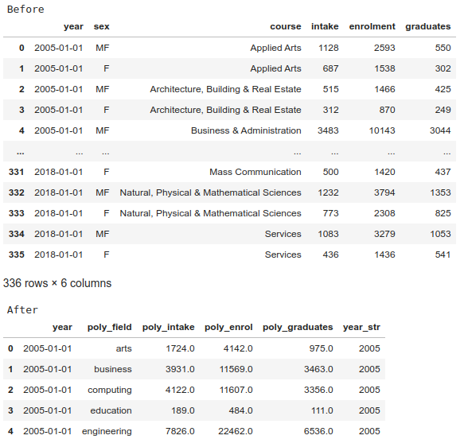
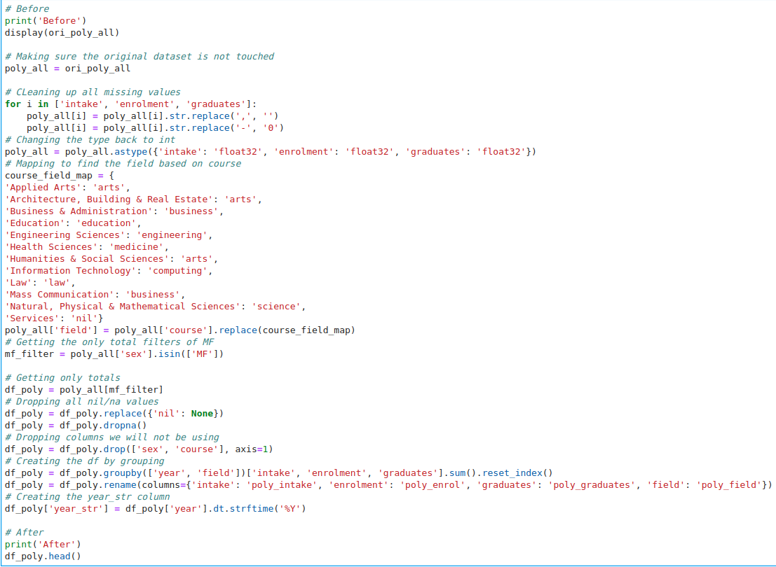
Data manipulation and Cleaning (Dataset 3)

Slide 20
Data manipulation and Cleaning (Dataset 4)
Same as dataset 3, cleaned the values and made columns like intake into floats
The mapped the course to their field of study
Only got the totals and grouped them by year and field of study
Also removed null fields that were not considered

Slide 21
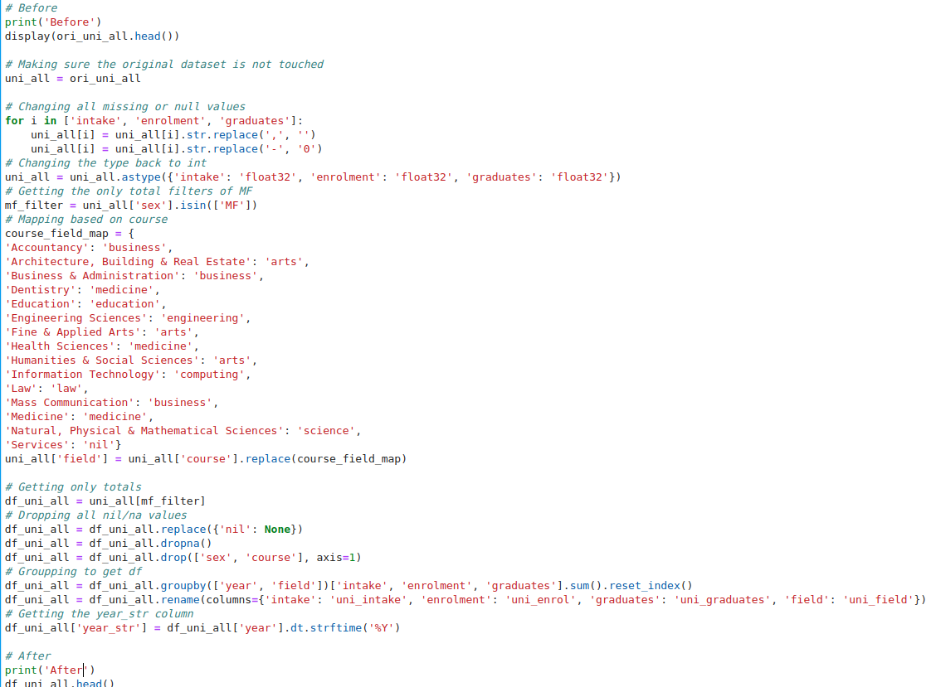
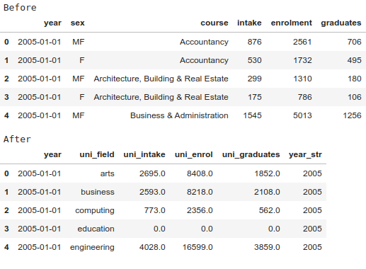
Data manipulation and Cleaning (Dataset 4)

Slide 22
Data manipulation and Cleaning (Dataset 5)
For this, I also had to clean the dataset, removing and replace null values
Then I was able to turn the columns like employment_rate_overall into floats
Also made a new field column based on the school degree was from
Then grouped by year and field, taking the mean of values

Slide 23
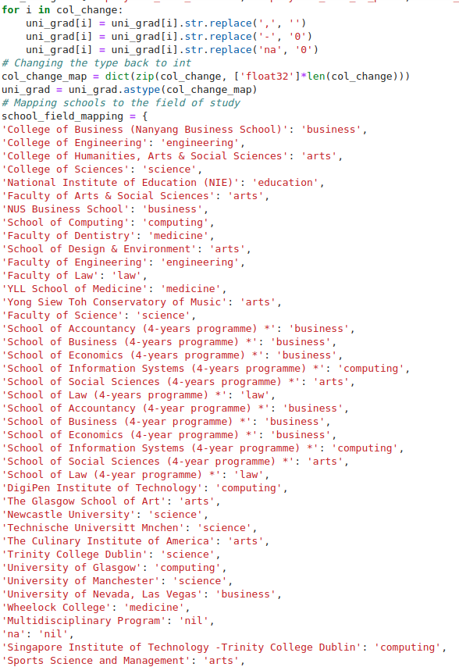
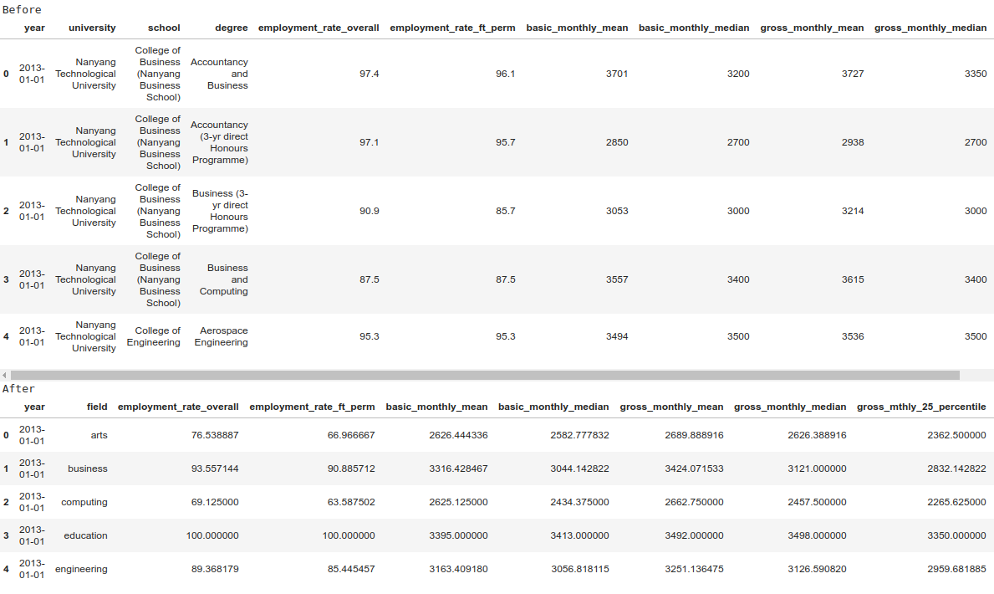
Data manipulation and Cleaning (Dataset 5)

Slide 24
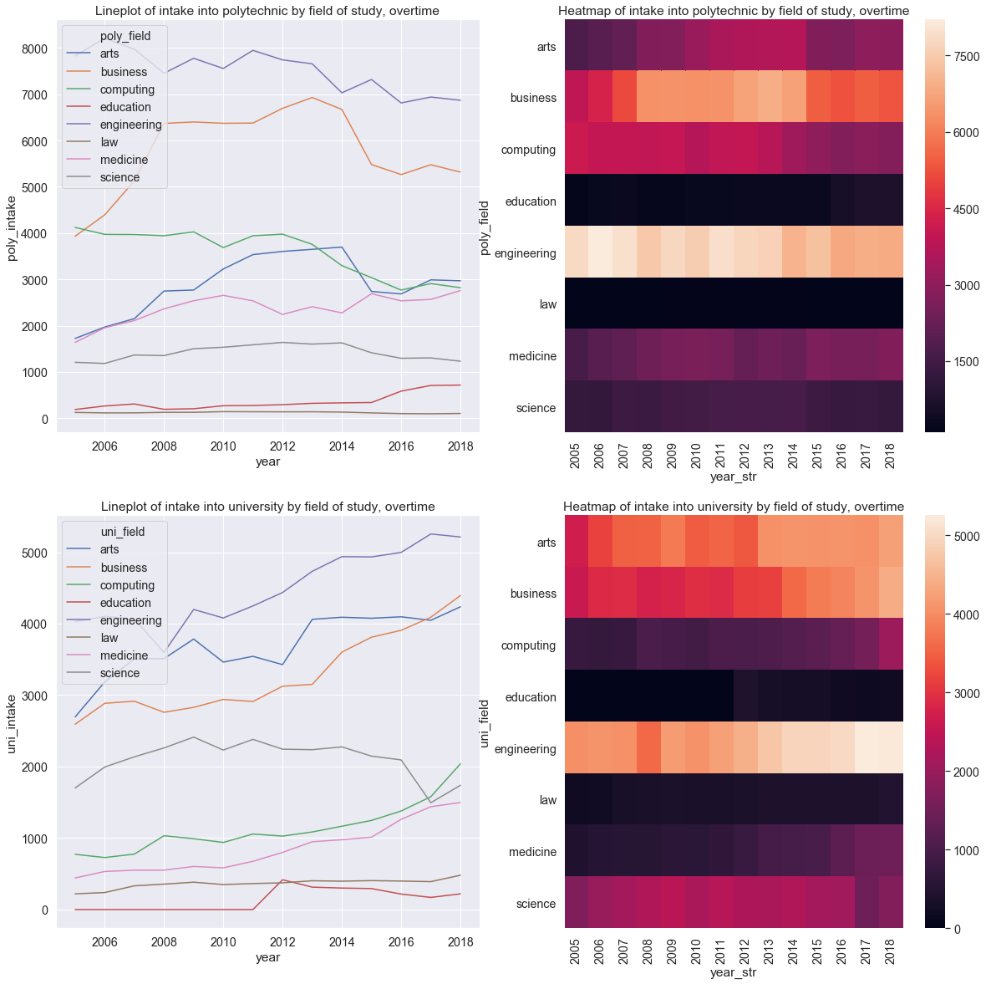
Analyzing the graphs
Figure 1 & 3
We can see here that the trends for polytechnic and university by fields are quite different
In polytechnic, engineering is the most popular followed by business
But in University, its engineering followed by arts and business
We can also see that the trends for different fields are also different.
Figure 2 & 3
Gives a more detailed look, we can see by the gradient, that for poly, it is engineering followed by business then arts, computing and medicine
Uni its, engineering then arts and business, followed by computing, medicine and science
Conclusions:
The more popular courses are engineering and business by far for both uni and polytechnic.
However it is hard to tell from the trends as for polytechnic, all of them are decreasing

Slide 25
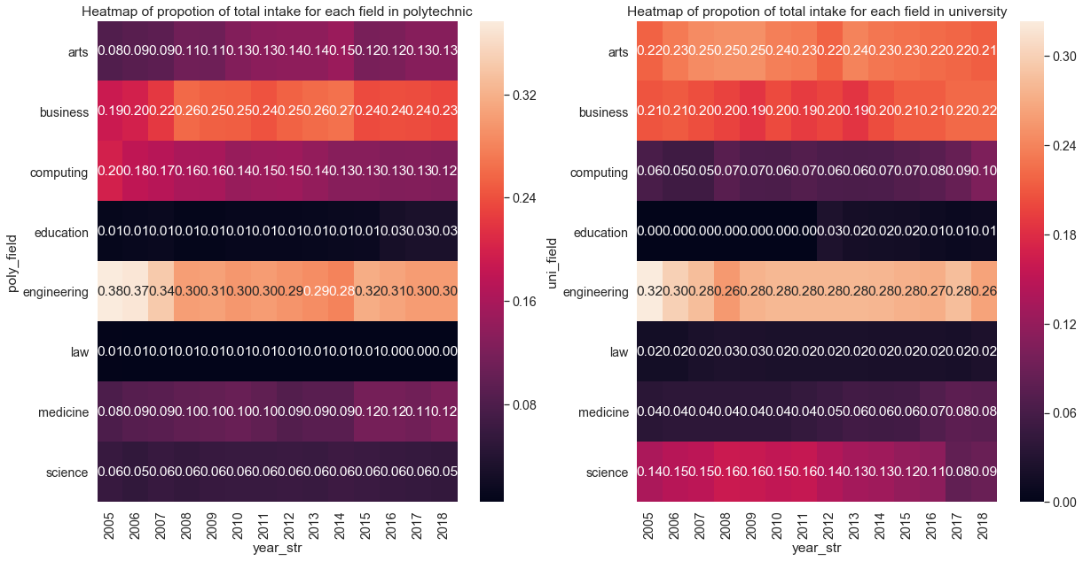
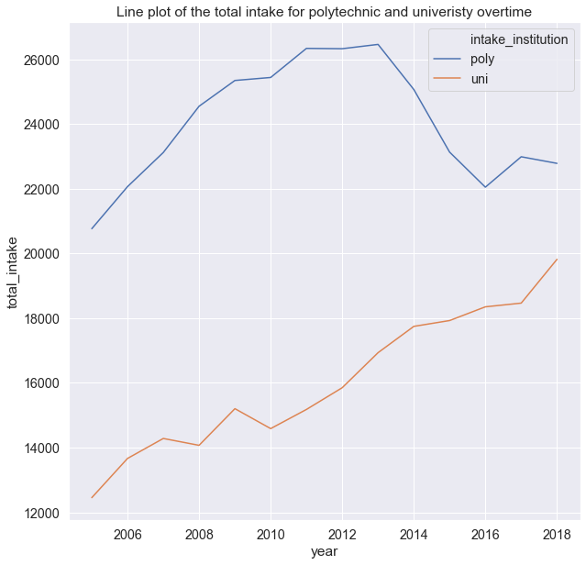
Analyzing the graphs
Figure 1 & 2
We can see here that engineering is indeed the popular field of study
However in uni, the popularity is actually decreasing as the proportion of intake is decreasing.
Figure 3
We can also see that the overall increase in intake for uni and decrease of poly
Thus even though we saw the downward trend for all fields of study in poly, it is probably due to this
Conclusion:
Thus we can conclude that engineering is the most popular field of study, however this may not tru in the future, with business and arts increasing in popularity

Slide 26
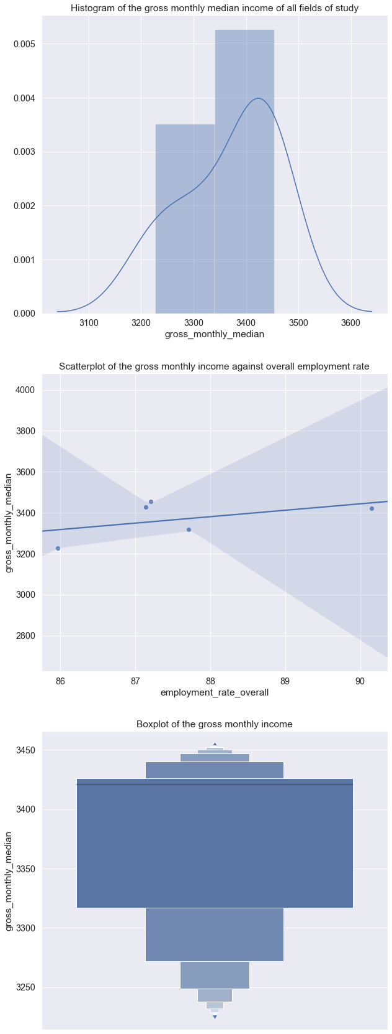
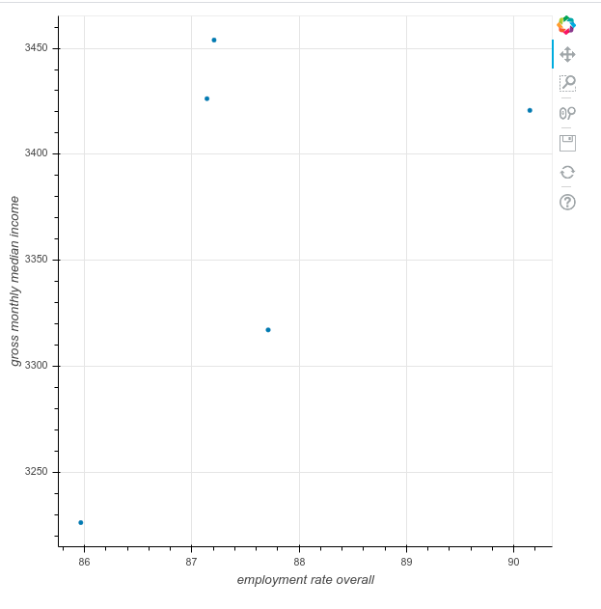
Analyzing the graphs
Figure 1, 2, 3 and 4
Some simple plots, we can see that the gross monthly income is normally distributed
The scatter plot shows some minor relationships
The boxplot shows there is a large range and variation

Slide 27
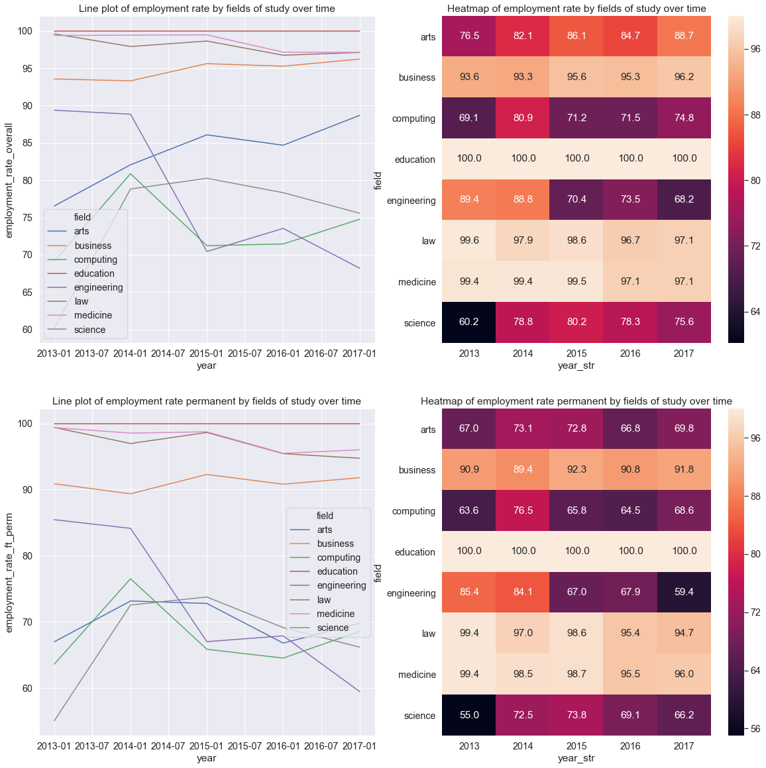
Analyzing the graphs
Figure 1 & 3
We can clearly see that for some fields, the employment rate and permanent employment rate is different.
Figure 2 & 4
We can see the most secure job is education
Close seconds are law, medicine and business
Although business permanent employment rate is much lower
Conclusion:
The field of study you take can significantly vary you employment rate
This also changes year after year

Slide 28
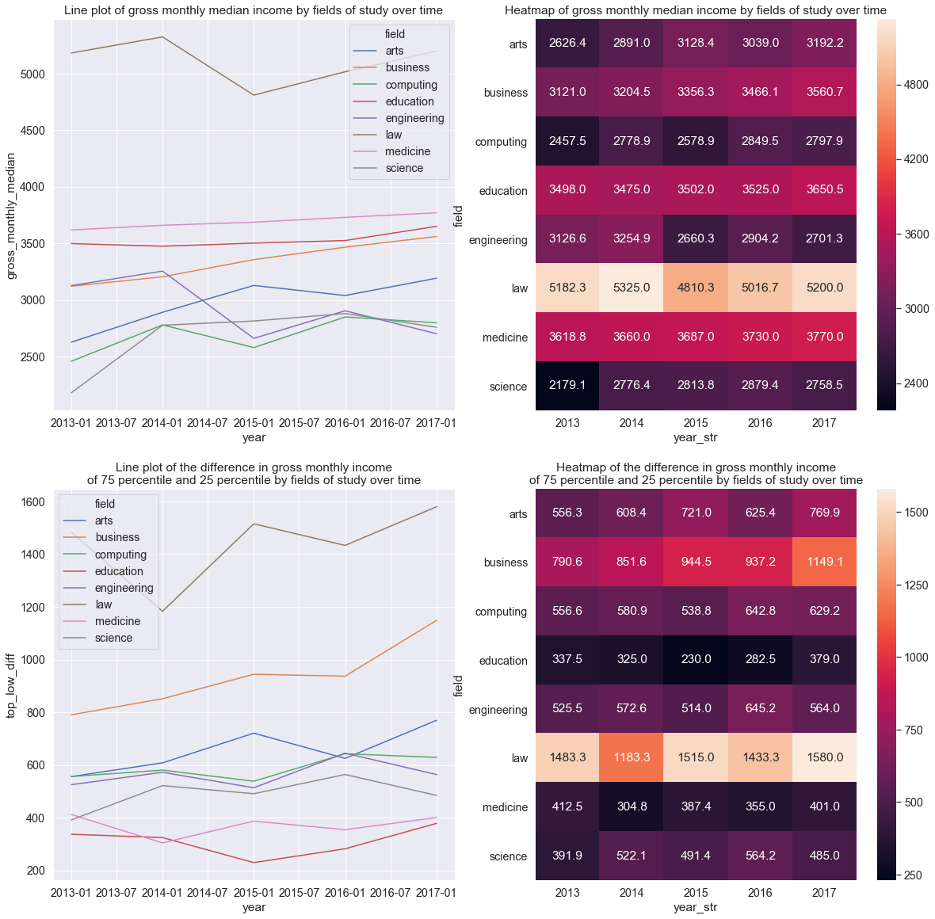
Analyzing the graphs
Figure 1 & 2
We can see that the highest earner by far is law
With medicine, education and business coming in together
Figure 3 & 4
We can see there is also a large difference in the income of law students, meaning their pay is very much affected by their school grades
Same with business to a smaller extent
Lastly we can see this also affects the other fields, although not as much
Smallest difference is in the education field
Conclusion:
Different fields of study also earn different amounts of income
School grades also decides how much more you can earn depending on your field. (Law)

Slide 29
Final conclusions
Sub-Objective: Which field of study should I go into (Datasets 3, 4 and 5)
Which field of study is more popular?
Most popular is engineering then business
Which field of study has better job prospects?
Depending on what you are aiming for, the most stable is education.
University grades does not really affect your income
Best income is law
Deping on how good your grades are you could earn up to 1.6K more than the median

